Slide 1
Synthesizing realistic audio using generative adversarial networks
Justin Zhang

Slide 2

Dance of the Sugar Plum Fairy by Pyotr Tchaikovsky
Real recording
MIDI
~20,000 kB (full song)
(typically) Requires a group of people
Require years of experience with music
~20 kB (full song)
Can be made by one person
Require little to no musical expertise
Notes:
Let’s look some descriptors before actually experiencing it
Compare
(3) To make it sound the best it can sound
For both playing and writing music
(Listen to music)
FROM WRITER: Explain differences (violin staccatos, bells being more vibrant in real recording (MIDI bells seemed to be rushed)

Slide 3
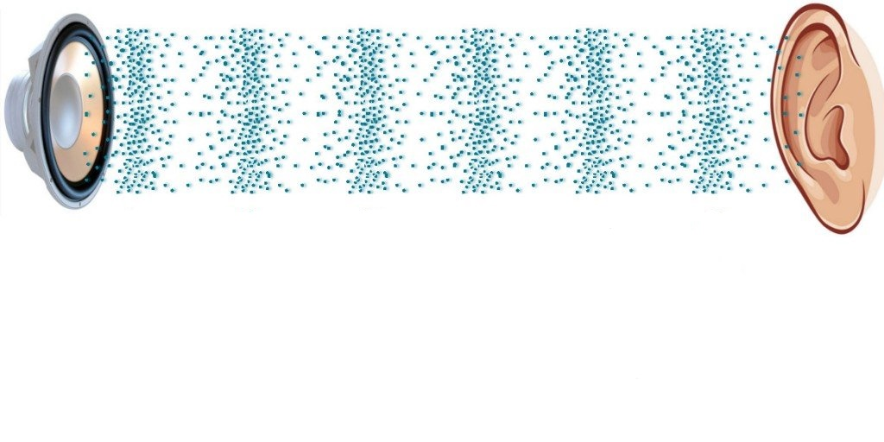
Audio

Slide 4
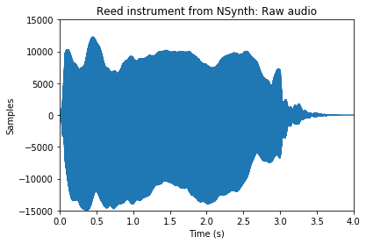
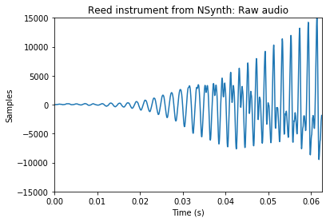
Raw audio
Notes:
This is what audio looks like
A microphone detects the air pressure
I didn’t use the audio for the recording because it was a bit noisy
This audio is from the dataset of small audio files I’ll be using, which I’ll describe a bit more later.
Zoomed in raw audio has three waves:
one very short
one being very long
one somewhere in between
There’s actually a way to quantify this “waviness.”

Slide 5
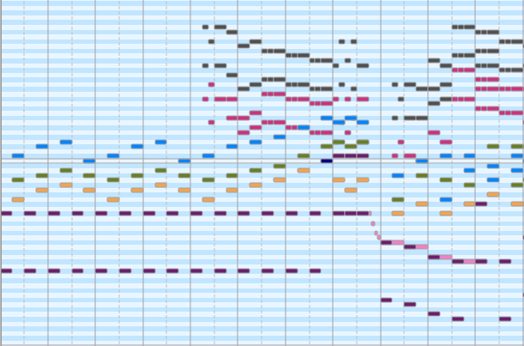
MIDI files
Notes:
Playback is generated by copying and pasting audio snippets
Lists of commands to play THIS INSTRUMENT at THIS TIME for THIS LONG
FROM MATTHEW: compare this representation to real audio

Slide 6
Raw audio
Notes:
This is what audio looks like
A microphone detects the air pressure
I didn’t use the audio for the recording because it was a bit noisy
This audio is from the dataset of small audio files I’ll be using, which I’ll describe a bit more later.
Zoomed in raw audio has three waves:
one very short
one being very long
one somewhere in between
There’s actually a way to quantify this “waviness.”

Slide 7
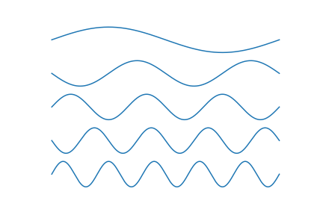
Fourier transform
Notes:
The Fourier transform separates out a wave signal into these sine waves
Any wave signal can be represented as different sine waves

Slide 8

Fourier transform
Notes:
For example, this sawtooth wave can be deconstructed as an infinite series of sine waves
Given a frequency and a time period, the Fourier transform outputs a complex number
FROM SOMEONE: describe inputs and outputs of Fourier transform, maybe with pictures

Slide 9
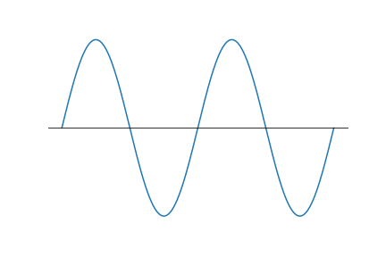
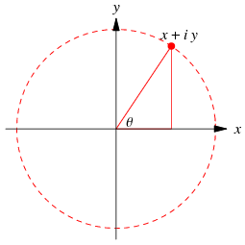

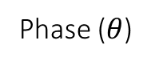
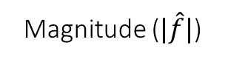
Phase ($θ$)
Magnitude ($|\hat{f}|$)
Audio reconstructed without phases
Audio reconstructed with phases
Original audio
Notes:
Need both magnitudes and phases to reconstruct audio
FROM WRITER AND RONAN: Describe complex numbers better, as point, maybe collab w/ Ayush

Slide 10
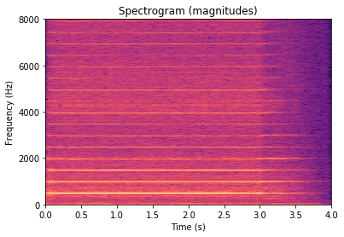
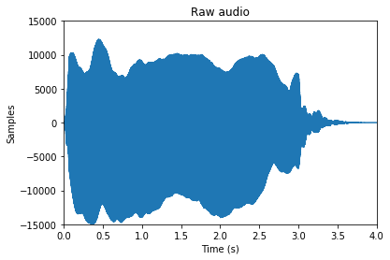
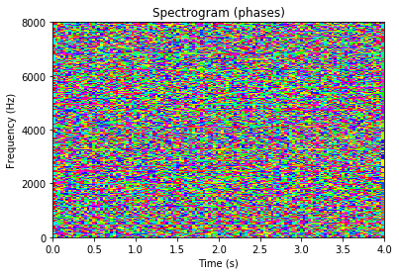
Spectrograms
Notes:
Spectrograms are just a 2D representation of many Fourier transforms
Again, this audio is from the dataset I’m going to use
Pixel in spec = small window in audio

Slide 11
Can MIDI files sound good?
Notes:
Use the information stored in the MIDIs (instrument types, length of instrument, instrument interaction)

Slide 12
Machine learning
Model learns itself
Can effectively model organic data
Speech recognition and generation
Image classification
Caption generation
Generalization
Notes:
As opposed to handwriting a model, model learns itself
FROM WRITER AND DEORAH: Add a picture, any slide with just text is dead

Slide 13
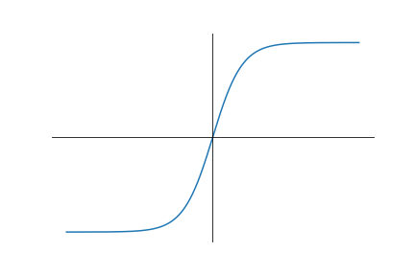
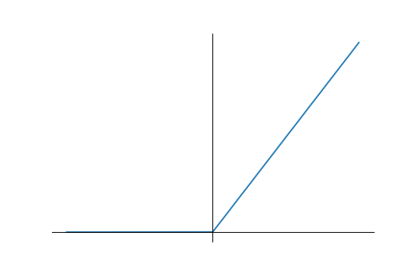
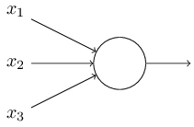
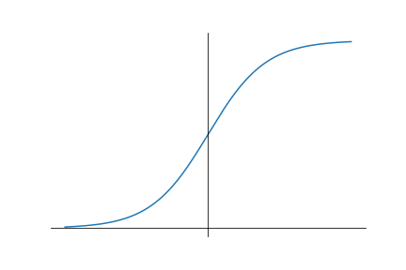
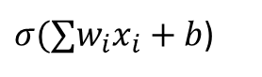




Neural networks (NNs)
$$w_{1}$$
$$b$$
$σ(∑w_{i}x_{i}+b$)
$$w_{2}$$
$$w_{3}$$
Neuron
Notes:
This is a single neuron

Slide 14
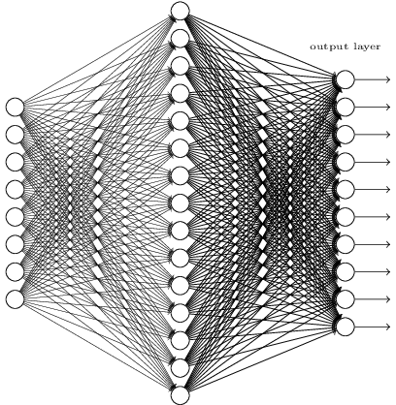
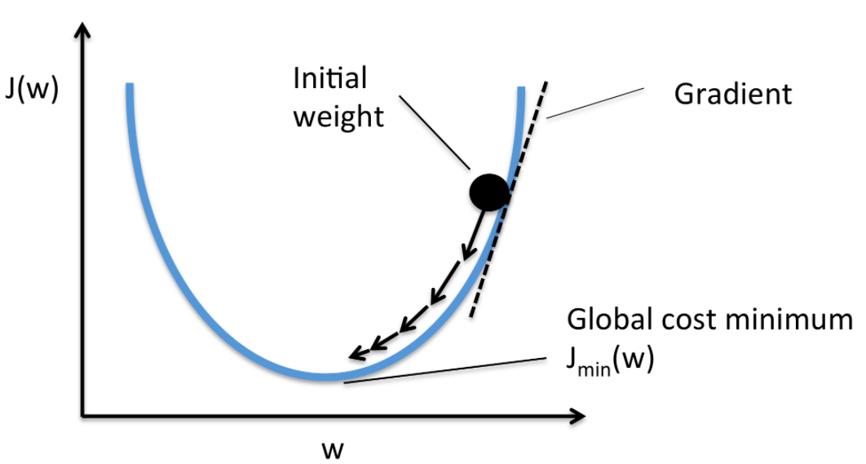
Neural networks (NNs)
Cost function
Backpropagation
Notes:
Activation functions
Cost function
Backpropagation

Slide 15

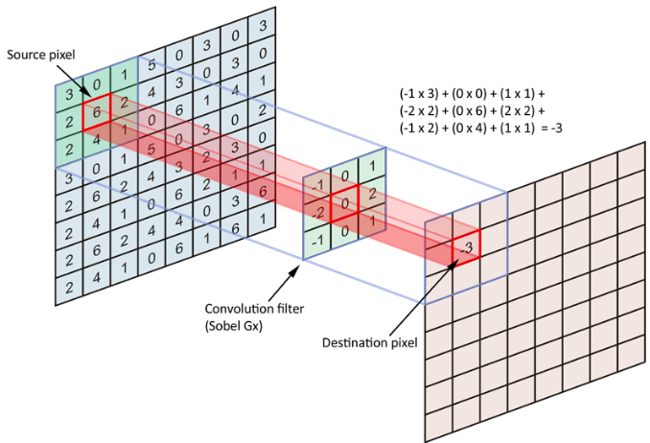
Convolutional Neural Networks (CNNs)
Notes:
Same weights and biases for the whole image
Fewer parameters
Faster training
More accurate modeling

Slide 16
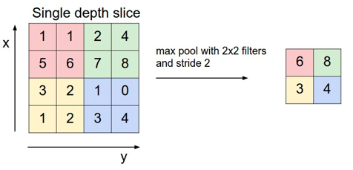

Notes:
Why are CNNs good for images
FROM WRITER: Make metaphors to explain hidden layer learning, Medium article

Slide 17


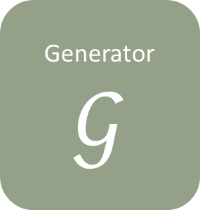

Generative adversarial network (GAN)
Generated picture
Generator
$$𝒢$$
Discriminator
$$𝒟$$
Real or fake?
Training picture
Latent space
Notes:
Why GAN over VAE?
Cost function less direct, better generalization
FROM SOMEONE: Differentiate b/w latent space in VAE
Make pencil point different places
Mention dimensions in latent space
Connect VAE GAN and latent space

Slide 18

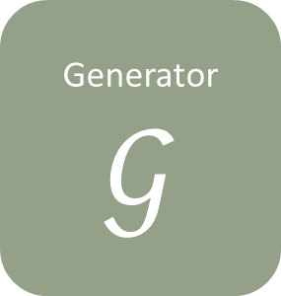

Generative adversarial network (GAN)
Generated picture
Generator
$$𝒢$$
Discriminator
$$𝒟$$
Real or fake?
Deep convolutional GANs (DCGANs)
Wasserstein GANs (WGANs)
Training picture
Latent space
Notes:
…
Training is notoriously hard
Discriminator optimizes too quickly and doesn’t provide a usable gradient for the generator
WGANs solve discriminator being too powerful
How this applies to initial problem:
MIDI could somehow be represented in the latent space
FROM MATTHEW: how I’m going to use DCGANs and WGAN into “WDCGAN”
FROM RONAN: Contrast vaes and gans and what I’m actually going to use in my project

Slide 19
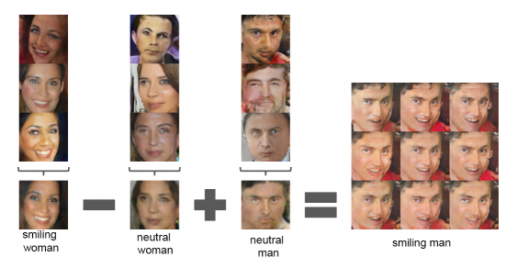

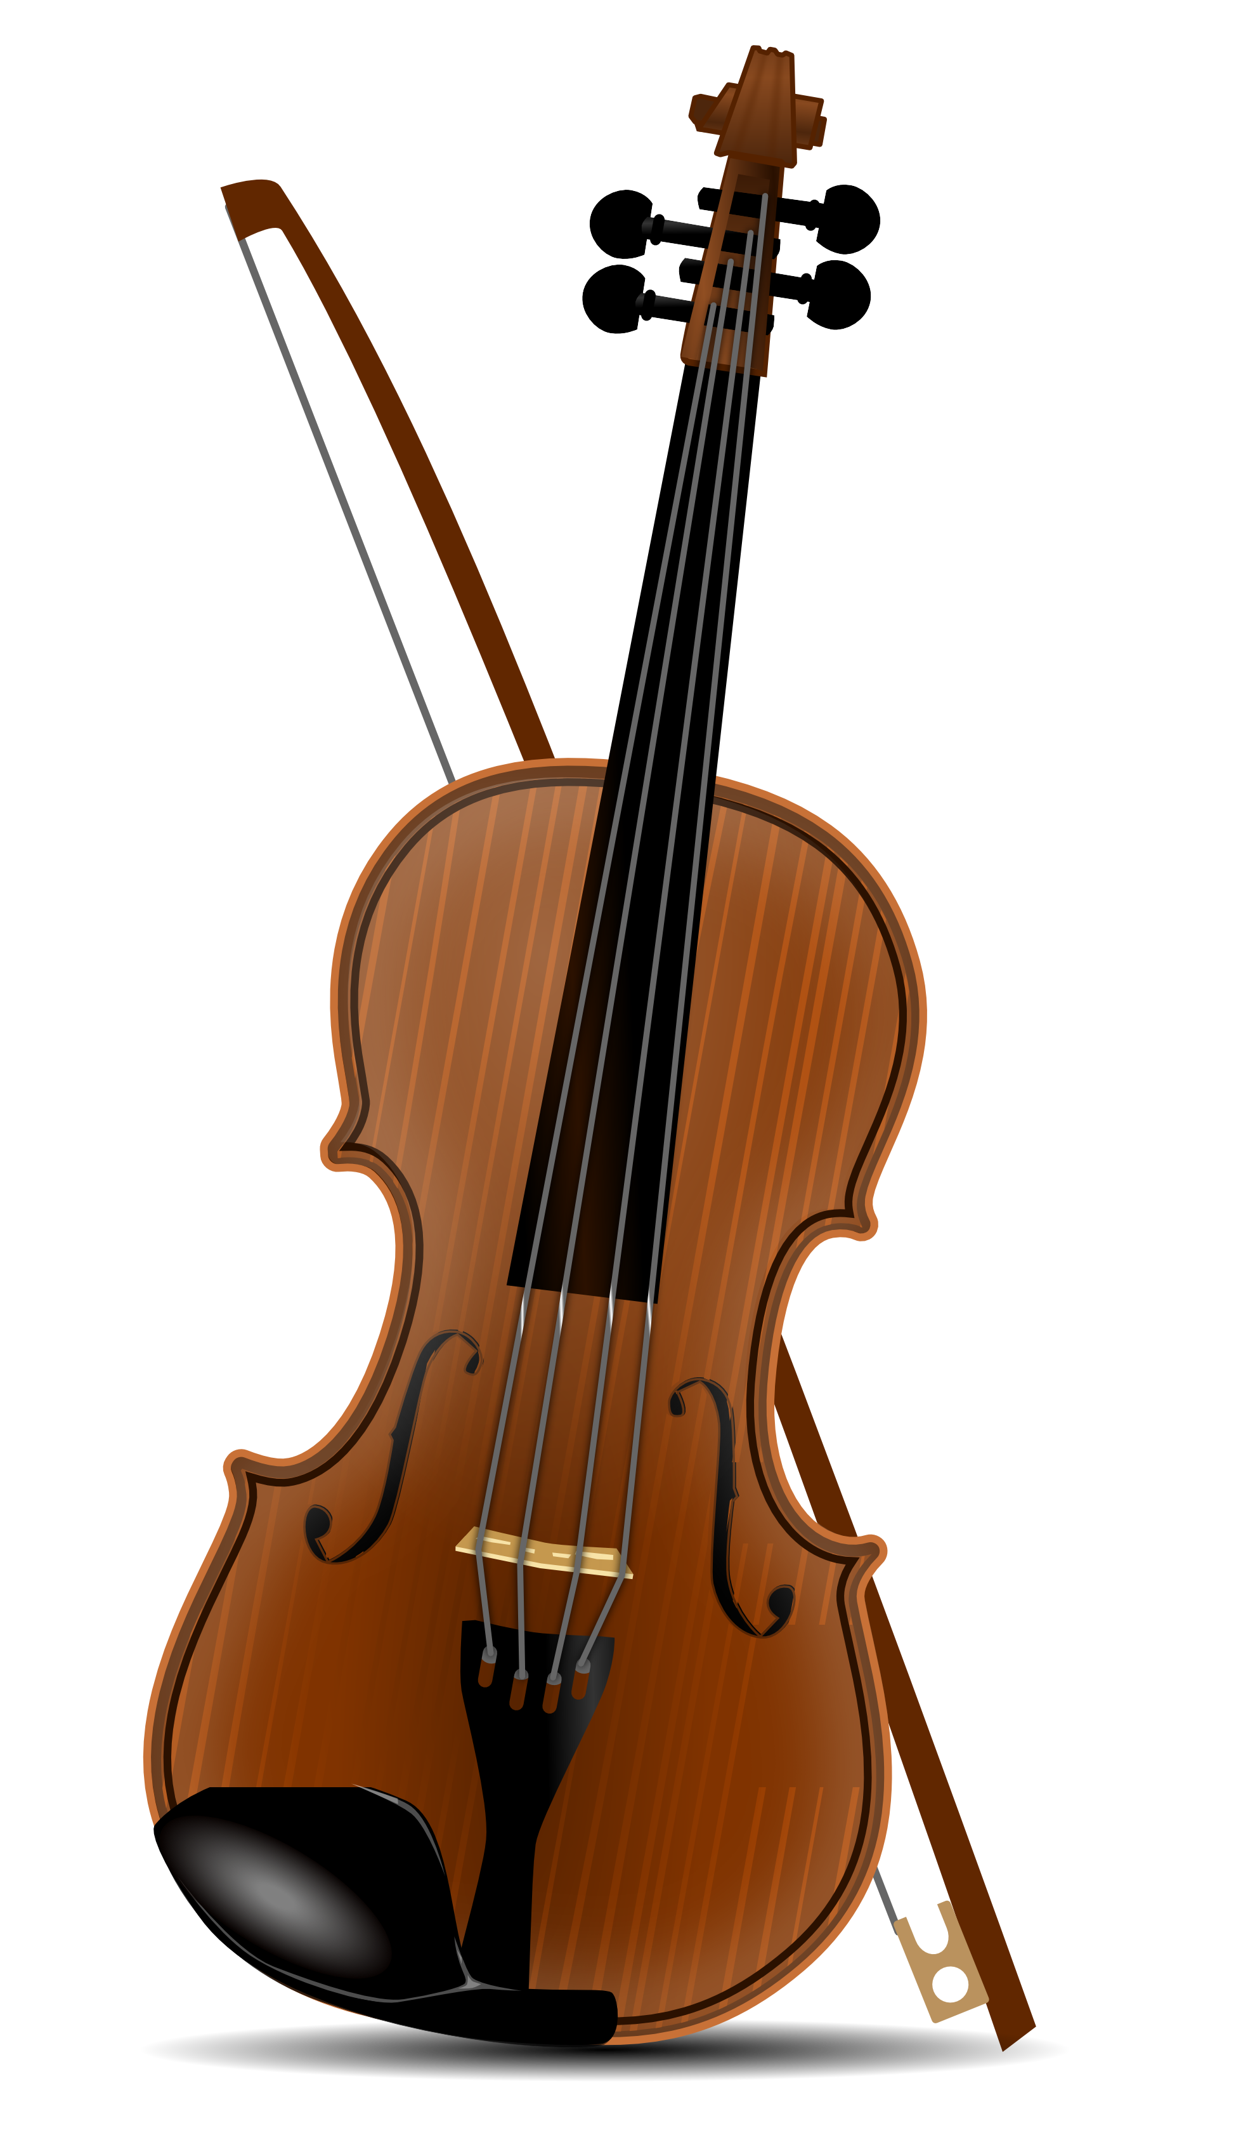
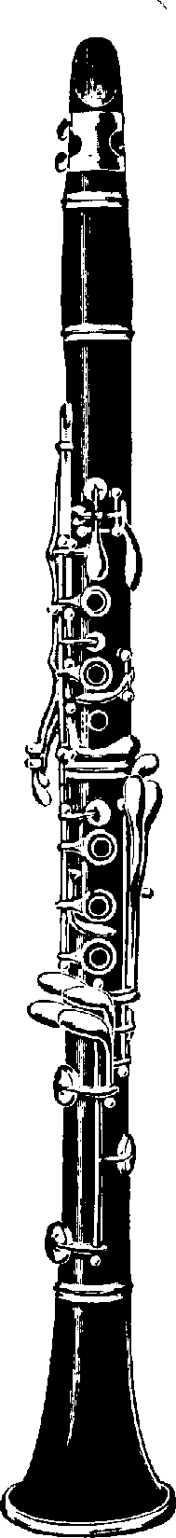
Walking the latent space
Notes:
It’s a way to more be able to more granularly control output of generator

Slide 20
Previous research
Notes:
FROM WRITER: connect more from this to my project, differentiate between previous research and this project and purpose
Reemphasize my uniqueness
FROM WRITER: Bring current research more prominently into presentation
Maybe how VAEs connect to this
Read details of paper more

Slide 21
Collecting data
Generating new data
Testing
Processing data
Key:
Finished
Work in progress
NSynth dataset of annotated audio from Engel et al. (2017)
Generate spectrograms from audio
Generative adversarial network
Listening to audio for quality
Extract phases and magnitudes from complex output
Tweak model hyperparameters
Import data into TensorFlow
Generate audio from spectrograms

Slide 22
Media references
Dance of the Sugar Plum Fairy audio is from the University of Arizona MIDI database (public domain) using a leading soundfont and from free-stock-music.com; all audio has been rescaled, and figures were made from this audio
The Nsynth datatset and WaveNet autoencoder diagram is from Engel et al. (2017)
Neuron and dense neural network diagrams are from Michael Nielsen’s “Neural Networks and Deep Learning,” licensed under a Creative Commons Attribution-NonCommercial 3.0 Unported License.
Loss curve diagram is from rasbt.github.io
Using Convolutional Neural Network for Determining Reticulocyte Percentage in Cats - Scientific Figure on ResearchGate. Available from: https://www.researchgate.net/figure/Convolutional-neural-network-LeNet-5-from-LeCun-et-al-4_fig1_323747175 [accessed 2 Dec, 2018].
Single convolution GIF is from https://github.com/vdumoulin/conv_arithmetic Accompanying paper is at arXiv:1603.07285v1 [stat.ML]
Non-GIF CNN diagrams were as seen in and as cited by “An intuitive guide to Convolutional Neural Networks” by Daphne Cornelisse
Autoencoder diagram is from Prof. Seungchul Lee’s GitHub: http://i-systems.github.io/HSE545/machine%20learning%20all/Workshop/CAE/06_CAE_Autoencoder.html
Walking the latent space diagram is from Radford, Metz, & Chintala (2016)
Violin in latent space slide is from clipart-library.com, clarinet is from dumielauxepices.net
All graphs were created by me in MatPlotLib
Notes:
Make better citations

Slide 23
References
Choi, K., Fazekas, G., Sandler, M., & Kyunghynn, C. (2017). Convolutional recurrent neural networks for music classification. ICASSP. doi:10.1109/ICASSP.2017.7952585, arXiv:1609.04243v3 [cs.NE]
Costa, Y. M. G., Oliveira, L. S., & Silla, C.N., Jr. (2017). An evaluation of convolutional nerual networks for music classification using spectrograms. Applied Soft Computing, 52(1), pp 28-38. doi:10.1016/j.asoc.2016.12.024
Creswell, A., White, T., Dumoulin, V., Arulkumaran, K., Sengupta, B., & Bharath, A. A. (2017). Generative adversarial networks: An overview. IEEE Signal Processing Magazine, 35(1), pp. 53-65. doi:10.1109/MSP.2017.2765202, arXiv:1710.07035v1 [cs.CV]
Engel, J., Resnick, C., Roberts, A., Dieleman, S., Eck, D., Simonyan, K., & Norouzi, M. (2017). Neural Audio Synthesis of Musical Notes with WaveNet Autoencoders. CoRR. arXiv:1710.07035 [cs.CV]
Goodfellow, I., Pouget-Abadie, J., Mirza, M., Xu, B., Warde-Farley, D., Ozair, S., … Bengio, Y. (2014). Generative adversarial nets. Advances in Neural Information Processing Systems, 27, pp. 2672–2680. arXiv:1406.2661 [stat.ML]
Pons, J., Slizovskaia, O., Gong, R., Gómez, E., & Serra, X. (2017). Timbre Analysis of Music Audio Signals with Convolutional Neural Networks. CoRR. arXiv:1703.06697 [cs.SD]
Radford, A., Metz, L., & Chintala, S. (2016). Unsupervised representation learning with deep convolutional generative adversarial networks. ILLR. arXiv:1511.06434 [cs.LG]

Slide 24
Things to fix (from 1st quarter, now outdated
MORE PICTURES, LESS WORDS (at least 2 pics per slide, don’t do it by words if you can picture)
Axes on spectrograms, label
Better bridges/connecting each slide to the next
More color contrast in workflow
Better hook
Key for workflow
Two audio side by side for midi
Audio for spectrogram without phases
Justification for project, both now and final goal
Real life application
Which part of slides go under workflow
Cite Medium.com workflow
Label diagrams better (axes on spectrogram, title of vaes and gans)
Elaborate on classification vs generation, maybe remove that slide or expand that slide
Could connect to imputation, need better bridge from previous slide to that one
Connect VAEs and GANs: encoder and generator parallel, how latent spaces connect

Slide 25
Generative models
Classification vs generation
Variational autoencoders (VAEs)
Generative adversarial networks (GANs)
Notes:
Classifying: training data is mapped inputs and outputs
Generating: machine tries to generate new images that would seem plausible; no obvious error or cost function to train to optimize
STILL FROM DEORAH AND WRITER: add picture, a slide with no text is a dead slide

Slide 26
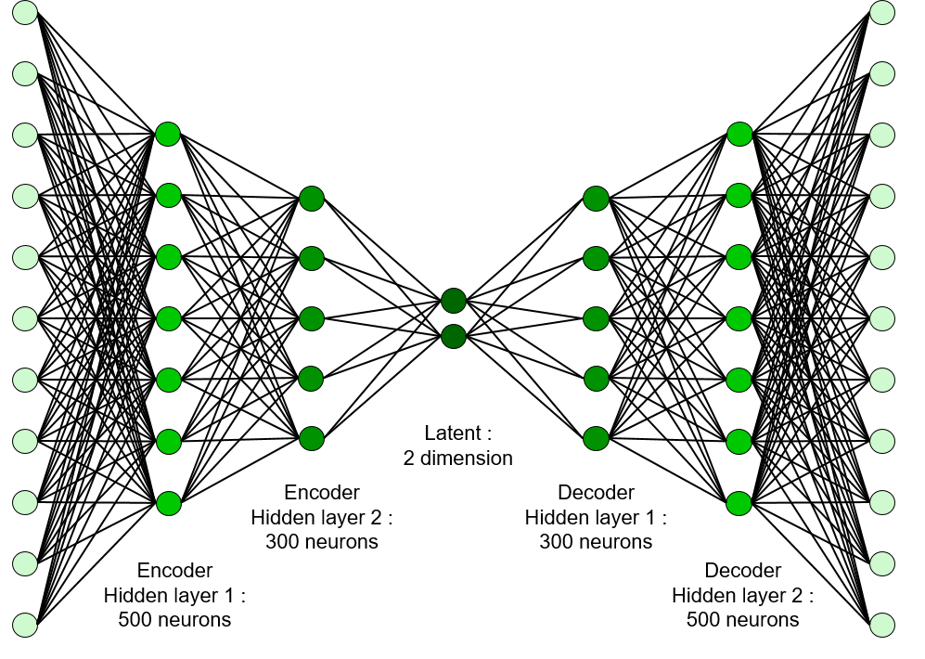
Variational autoencoder (VAE)
Encoder
Decoder
Notes:
Describe latent space

Slide 27
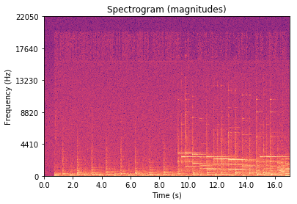
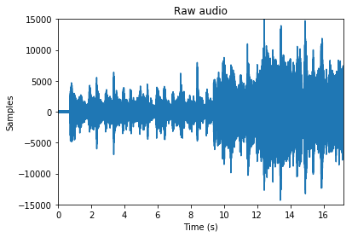
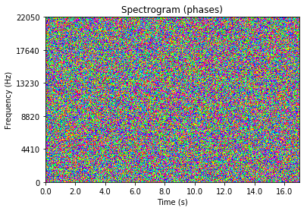
Actual recording
Notes:
Audio is stored as samples, so it’s hard to model directly using anything
Sample rate
Diaphragm
Spectrograms
Pitch
Initiation
Sustaining
Decay
Connecting with other notes
Timbre

Slide 28
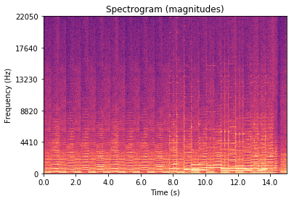
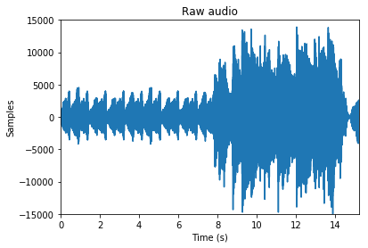
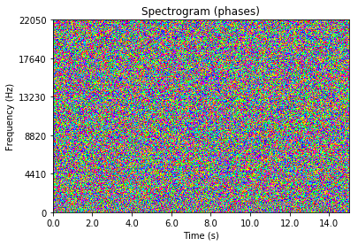
Audio from MIDI
Notes:
Right now thinking why spectrograms and not directly audio?
Spectrograms summarize audio, and classification of audio using spectrograms has been effective

